Slide 1


Computer Networks
Lecture (Chapter1)
Course organization and introduction
Subhan Ullah, PhD
subhan.ullah@nu.edu.pk
BS(Computer Science) Spring-2024

Slide 2
Agenda
Class Introduction
Course Introduction
Aims and objective of the course
Learning outcome
Course outline
Course learning materials
Teaching and assessment methodology
Course policies and some rules for the class discipline
Overview and roadmap of Chapter 1

Slide 3
About me!
Assistant Professor: Department of Cybersecurity, FAST School of Computing (FSC)
Education
Ph.D. (CS/IT under EMJD-ICE Scholarship): University of Klagenfurt, Austria and University of Genova, Italy (2015-2019).
MS(CS) Joint International Master (JIM): Study Exchange Program: Darmstadt, University of applied sciences, Germany (2013-2015)
MS(CS): International Islamic University, Islamabad (2010-2013)
Field of interest (Research + Teaching)
Cybersecurity, Securing IoT Applications, Smart Camera Networks, Sensor Networks and Vehicular Ad-hoc and Computer Networks
About my office: C-503C, Ext: 501, Office hours (five hours per week)

Slide 4
You and your learning expectations?
Please introduce yourself now ☺
What do you expect to learn from this course?
This course is about …
Network principles and concepts
General purpose computer networks
Internet perspective: Major components of the Internet protocol suite
Network software
Designing and building a system
We will learn what, how and why networks are like they are…

Slide 5
Aims and objective of the course
To familiarize the students with basic computer and communication networking technologies and the layered approach
that makes design, implementation and operation of computer and communication networks possible
Explores in detail the concepts
of layering, routing, congestion control, and medium access control
The course follows a top-down approach, commencing with networking applications
and to motivate the study of networking protocols, architectures and principles
Finally, the basics of wireless and mobile networks are introduced in the course

Slide 6
Course outline
Introduction to Internet & Protocols, Network Edge/Core, Delays
Service Models and Security
Application Layer
Transport Layer
Network Layer
Data Link Layer
Note: Detailed outline would be uploaded on SLATE/Google Classroom

Slide 7
Learning outcome
After completion of the course, you will be able to:
Define Internet, Network Edge/Core, Delay, Loss, and Throughput
Identify protocol layers, service models, and different network security issues
Define network applications and Application Layer protocols
Implement Client Server communication using socket programming
Identify Transport Layer services, differentiate between reliable and unreliable services, and define flow control and congestion control
Classify, analyze, and design IPv4 addressing schemes, and differentiate between routing and forwarding on Network Layer
Identify and design: subnetting, CIDR, Design, calculate, and apply subnet masks and addresses to fulfill networking requirements
Describe VPN, NAT, ICMP
Identify Link Layer services, and define link layer addresses
Describe ARP, Ethernet, and differentiate between Switches and Routers
Notes:
Internet Control Message Protocol (ICMP)
Address Resolution Protocol (ARP)
Classless inter-domain routing (CIDR)
network bandwidth is defined as the maximum transfer throughput capacity of a network.
Throughput measures how many packets arrive at their destinations successfully.

Slide 8




Course learning materials
Text Book:
James F. Kurose and Keith W. Ross, “Computer Networking: A Top-Down Approach” 8th Edition, Pearson.
Reference books:
Behrouz A. Forouzan, “Data Communications and Networking” 5th Edition
Andrew S. Tanenbaum and David J. Wetherall, “Computer Networks” 5th Edition, Pearson.
William Stallings, “Data and Computer Communications” 8th Edition, Pearson.

Slide 9
Teaching and assessment methodology
Teaching
Lectures + class activities, quizzes etc.,
Schedule: two teaching units (1 hour and 20 min each) per week
Tentative evaluation and assessment method (100 absolutes)
Assignments (3): 10%
Quizzes (5): 8%
Project (Lab): 7%
Exams (Sessional-1, Sessional-2 and final Exam):15%, 15% and 45%
All the materials and announcements will be shared on Google classroom
Google classroom code: qg7pjwe
Google classroom Link: https://classroom.google.com/c/NjU0OTIwNTEyMzI3?cjc=qg7pjwe

Slide 10
Course policies
Grading policy
Absolute grading scheme
Missed assessment items
Retake of missed assessment items (other than sessional/ final exam) will not be held
For a missed sessional/ final exam, an exam retake/ pretake application along with necessary evidence are required to be submitted to the department secretary
The examination assessment and retake committee will decide the exam retake/ pre-take cases

Slide 11
Consequences of dishonesty
Plagiarism/cheating in sessional or final exams may result in F grade in the course
Any kind of cheating or plagiarism in project or in an assignment will result in zero marks in that project or assignment
Please do not cheat yourself!
☺
“I would prefer even to fail with honor than win by cheating”
Sophocles

Slide 12


Some rules for the class discipline
Raise your hand before asking any question and then WAIT for the permission
Never ever miss a class
No attendance for late comers (Be aware attendance less than 80 % will debar you and not allow you for the final exam)
Never use mobile phone in the class
Mobiles must be switched off at the start of a lecture and must be put in pocket i.e., mobile should not be seen in anyone’s hand or on desk
Never ever sleep during the lecture
Be active,
and never try a fake awake

Slide 13
What are the Goal of the course?
Build a computer network which
Can grow to global proportions
And support diverse applications
to understand the underlying building blocks
available technologies to use
Integration of the building blocks to communicate
And which software architecture to use

Slide 14

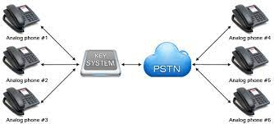
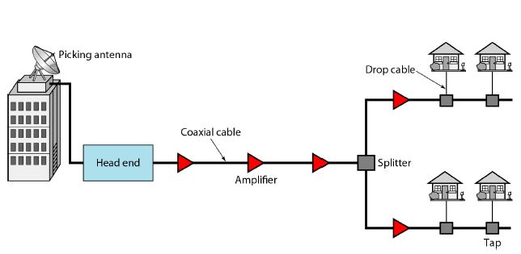
Network Design
What a network is?
Set of serial lines to attach terminals to a desktop computer?
Specialized to handle keystrokes
Telephone network carrying voice traffic?
Specialized to handle voice
Cable network to disseminate video signals?
Specialized to handle video
Other examples: Cellular, Adhoc networks, VSN, and IoT networks etc.,

Slide 15
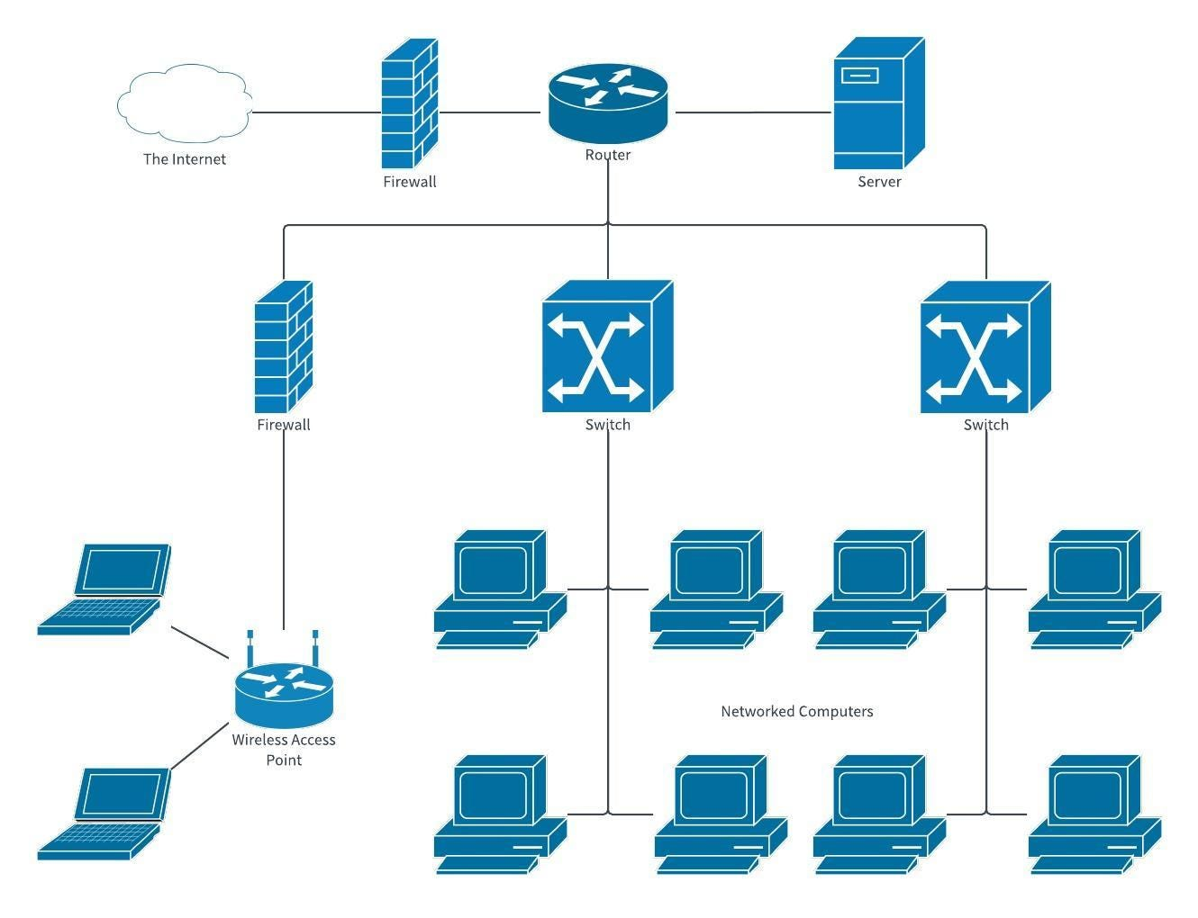
Computer Networks
What distinguishes a Computer Network?
Generality: built from general purpose programmable hardware
Supports wide range of applications
Geographically located anywhere
Objective is to exchange data, images, videos, voice etc.,
Small Office Network Diagram

Slide 16
Network Overview
What must a network provide ?
Connectivity
Cost-effective sharing
Functionality
Performance
Openness
How are networks designed and built?
Layering
Protocols
Standards

Slide 17
Network perspectives
For an user
Connectivity: for services required; error free delivery within acceptable time limits
For a designer
Efficiency: cost-effective design, fair allocation and efficient use of resources
For an operator
Maintenance: easy to administer, fault localization & isolation, usage accounting

Slide 18
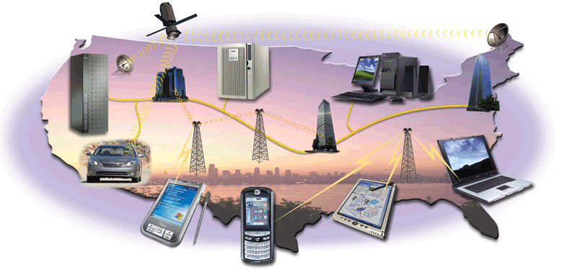
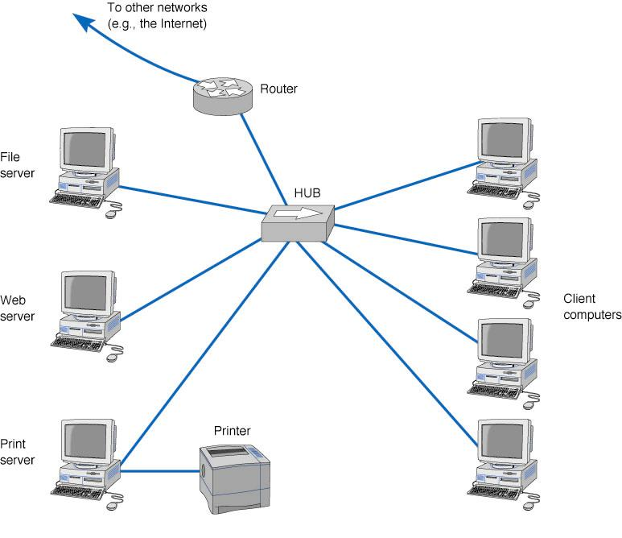
Computer Network and its components
What is Computer network?
A group of computers connected together to communicate, exchange data, and share resources in real time
Computers on a network may be linked through Internet cables, telephone lines, radio waves, satellites, or infrared light beams
A network can be defined recursively as:
Two or more nodes connected by a physical link
Or two or more networks connected by one or more nodes
Notes:
Covered until here….

Slide 19
Our Road Map …
Fortunately, we are not the first to build a computer network
Lets start exploring the path that others have already dig deep
By asking (and answering) why networks are designed the way they are

Slide 20
Computer network (advantages and disadvantages)
Advantages:
Simultaneous access to data
Sharing of hardware resources
Collaborative work by multiple people
Personal communication
Reliability of the system etc.,
Disadvantages:
Costs of network
Lack of robustness and independence
Easy spread of viruses and malware etc.,
Any other advantages?
Any other disadvantages?
Notes:
Data files are shared
Data are stored in a centralized place
All users have access to identical, up-to-date information
Software can also be shared
Site licenses
Sharing of hardware resources
Printers and faxes are commonly shared devices
Reduces the cost per user
Collaborative work by multiple people
Personal communication
Email
Instant messaging
Conferencing
Videoconferencing
Voice over IP
Phone communication over network wires
Easier data backup
Usually in business corporations
Employers keep the data on a shared storage device
The network manager makes regular backups of the data
Correctness : The ability of software products to perform their exact tasks, as defined by their specification.
Robustness : The ability of software systems to react appropriately to abnormal conditions.
Reliability : A concern encompassing correctness and robustness.

Slide 21

Thank You All
☺
?
A note on the origin of these ppt slides:
All material copyright 1996-2020 J.F Kurose and K.W. Ross, All Rights Reserved
These slides are freely provided by the book authors and it represents a lot of work on their part. We would like to thank J.F Kurose and K.W. Ross.

